Slide 1
Otters at Play
Brandon Taylor (Coral Glades High School)
Juan Cotes (Cypress Bay High School)
Carson Ramsay (Coral Springs High School)

Slide 2
App Content
Meet The Otters: introduce all four otters.
Behind the Scenes: discussion of care at the museum.
Otters Gone Wild: describe activities and diet in the wild.
Anatomy: show a 3-D otter and basic facts about river otters.
The Hidden Dangers: highlight the problems humans cause for river otters.
Quiz: simple educational quiz for users to test themselves.
Map: to link the app to an interactive map of the museum.

Slide 3
Demo
https://www.youtube.com/watch?v=6ZtYtl3hyWI

Slide 4
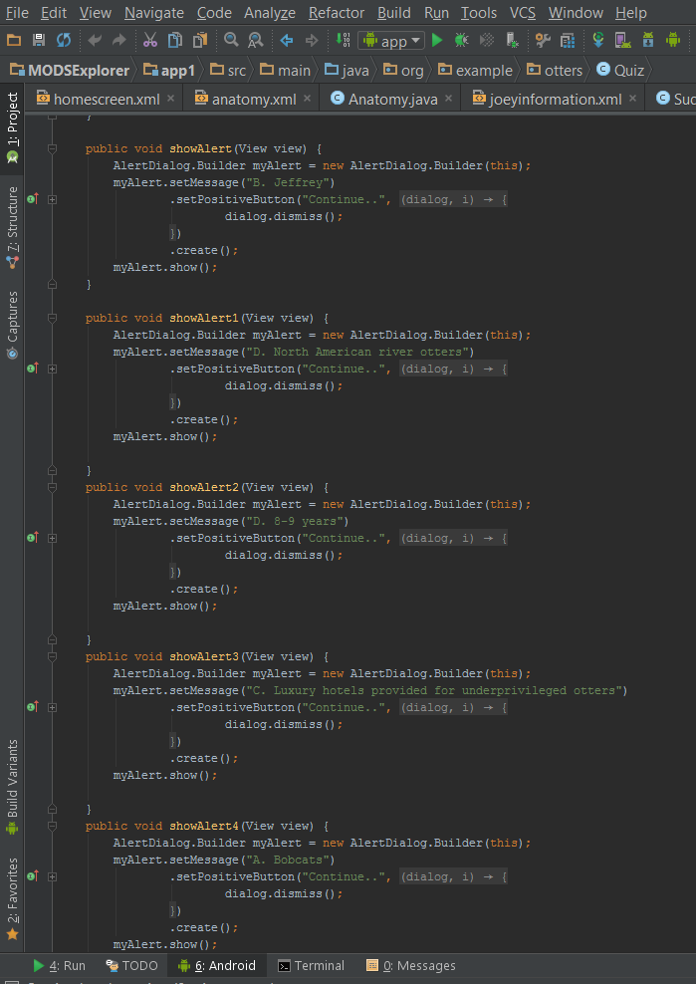
Programming
msgText_TextView = (TextView) findViewById(R.id.textView2); msgText_TextView.setSingleLine(false); msgText_TextView.setMaxLines(10); msgText_TextView.setVerticalScrollBarEnabled(true); msgText_TextView.setHorizontalScrollBarEnabled(true); msgText_TextView.setScrollBarStyle(View.SCROLLBARS_INSIDE_OVERLAY); msgText_TextView.setMovementMethod(new ScrollingMovementMethod()); //to add new line + "\n" + String txt = "Their life expectancy is 8-9 years in the wild and up to 21 years in captivity. They have Extremely flexible bodies, webbed toes and strong claws on all four feet, tails that take up about one third of the total body length, flattened heads with short thick necks and dense velvety fur. North American river otters are about 3-4 feet long including their tail. The tail makes up about 1/3 of their total length. They usually weigh between 11 to 30 pounds. Males are generally larger than females."; msgText_TextView.setText(txt);
final VideoView videoView = (android.widget.VideoView) findViewById(R.id.videoView1); Uri video = Uri.parse("android.resource://" + getPackageName() + "/" + R.raw.found_otter); //do not add any extension videoView.setVideoURI(video); videoView.start(); videoView.setOnPreparedListener(new MediaPlayer.OnPreparedListener() { @Override public void onPrepared(MediaPlayer mp) { mp.setLooping(true); } });

Slide 5
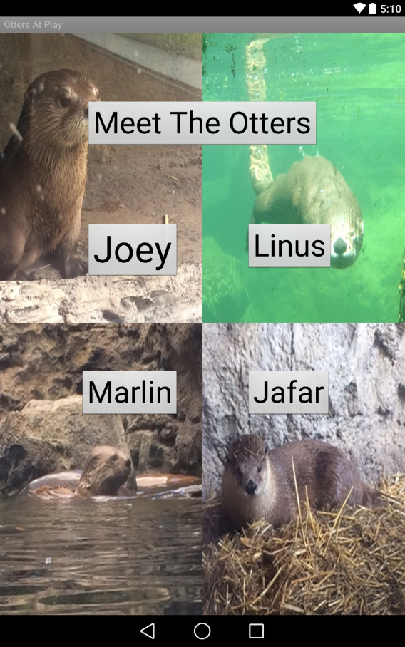
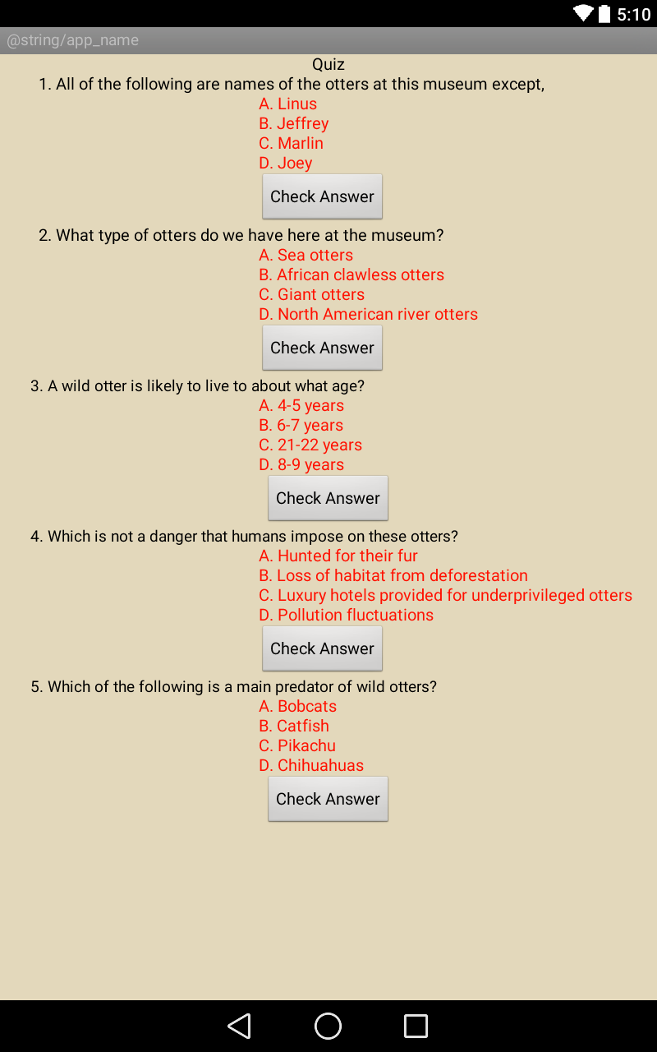
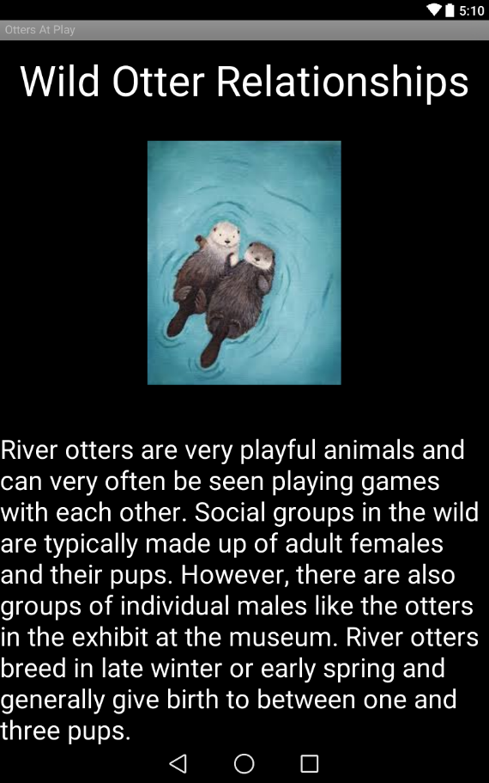
U.I.

Slide 6
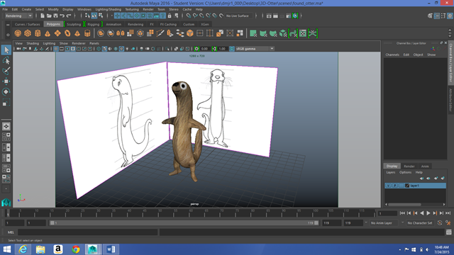
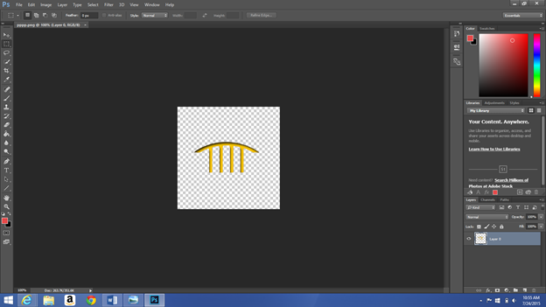
Graphics

Slide 7
Credits
Teachers
MODS
The United Way of Broward County
Our parents
Our schools

Slide 8

Questions

